Slide 1
ZOO ANIMAL CLASSIFICATION
By
Rosh Raval
July
2019

Slide 2
Why is Animal Classification important?
Classification is used across all fields every day in everything we do such as in the implementation of medical diagnoses, in the filtering of spam from ham, in the learning of associations between product purchases, in the determining of loan disbursement criteria, and in the recognition of images and speech.
Animal classification can be helpful in identifying attributes associated with different animals in order to understand the animal kingdom better.

Slide 3
Who is this important to?
Scientists
Zoologists
Researchers
Archeologists
Park Rangers
Paleontologists
Wildlife Conservationists
Microbiologists
Veterinarians
Educators

Slide 4
Data Wrangling
Source: UCI Machine Learning Repository, [http://archive.ics.uci.edu/ml],( Irvine, CA: University of California, School of Information and Computer Science)[1]
Dataset comes from the UCI ML repository and consists of 99 unique animals with two frogs(one venomous and one not).
Data cleaning included removing the index ’girl’, adjusting the animal species class 1 count, changing ‘tail’ to ‘tails’, merging two datasets on a common column and dropping non-essential and non-numerical columns before beginning Scikit-Learn ML models.
Dataset did not need to be melted and contained no missing values.

Slide 5
CORRELATION HEATMAP
WHAT CORRELATION TRENDS CAN BE FOUND FROM THIS HEATMAP?

Slide 6
CORRELATION TRENDS:
1.) High correlation between teeth and backbone which is due to "Teeth being formed from the neural tube, the embryonic tissue that becomes the brain and spinal cord.[2]“ 2.) High correlation between aquatic and fins. 3.) High correlation between tail and backbone, which according to Carnegie Museum of Natural History[3], is because "the tail is part of the caudal vertebrae". 4.) Low correlation between domestic animals and predators. 5.) High correlation between breathing and animals with hair and strong negative correlation between not breathing and fins since gills collapse out of water.

Slide 7
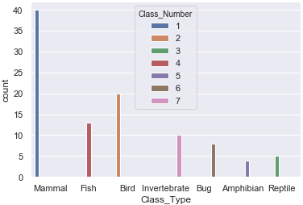
Which class number has the most animals?
Class Number 1 (Mammals) which includes aardvarks, antelopes, bears, elephants, etc.

Slide 8

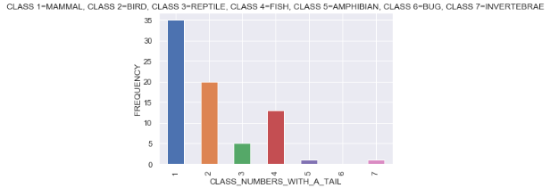
What does the bar plot below show?
The bar plot shows that 75% of all animals in the dataset have tails and 50% of those animals are mammals (Class 1).
The bar plot shows that very few amphibians and invertebrates have tails (Class 5 & 7).
The bar plot shows that birds, reptiles and fish all have tails (Class 2, 3 & 4).
The bar plot shows that bugs (Class 6), consisting of only 8 total animals, do not have tails and that tails may not be the strongest feature for animal classification.

Slide 9
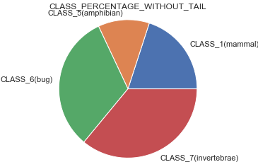
There was a high correlation between animals having a backbone and animals having a tail so does this mean that animals without a backbone are correlated with animals not having a tail?
The pie chart shows this exact correlation and shows that the highest percentage of animals without a backbone are invertebrates.

Slide 10
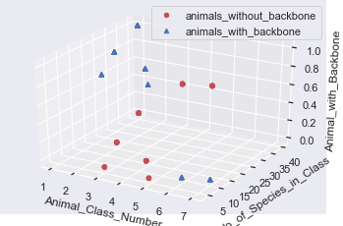
•The scatterplot showed that all animals in classes 1, 2, 3 ,4 and 5 have a backbone. •The scatter plot showed that none of the animals in classes 6&7 (invertebrates and bugs) have a backbone. •The scatter plot showed that backbone may not be the strongest feature for animal classification.
What does the 3D scatterplot show?

Slide 11
What does the 3D histogram show?
The histogram shows a strong correlation between animals having a backbone and having teeth and shows the reason the correlation is only 0.6 may be due to the animals without a backbone having teeth.

Slide 12
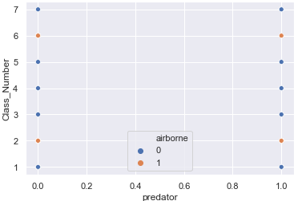
The scatterplot validates the correlation heatmap finding that the majority of predators are not airborne. It also shows that predator may not be the strongest feature in animal classification.
What does the scatterplot show?

Slide 13
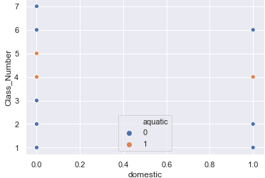
What does this scatterplot show?
•The scatterplot shows that domestic animals fall in classes 1, 2, 4 and 6 (mammals, birds, fish and bugs) and that all of the classes contain animals that are not domestic.
•The scatterplot shows that the only aquatic domestic animals are class 4(fish) and that domestic may not be the strongest feature in animal classification.

Slide 14
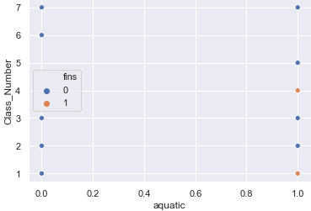
•The scatterplot shows that finned animals belong to classes 1 & 2(mammals and fish). •The scatterplot shows that 6 out of the 7 total classes include animals that are aquatic and that 5 out of the 7 total classes include animals that are not aquatic. •The scatterplot shows that aquatic may also not be the strongest feature for animal classification.
What does the scatterplot show?

Slide 15
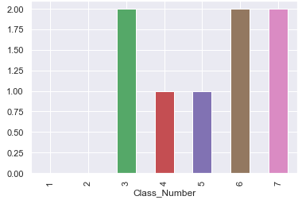
What does this bar plot show?
•The bar plot showed that there were no venomous animals in classes 1 & 2 (mammals and fish).
•The bar plot showed the majority of venomous animals are in classes 3, 6 and 7(reptiles, bugs and invertebrates).
•The bar plot showed the attribute venomous may not be the strongest feature in animal classification.

Slide 16
Hypothesis Testing
null hypothesis(Test 1): animals that can breathe that have fins - animals that can't breathe that have fins = 0
null hypothesis(Test2): animals that are domestic that are predators - animals that are not domestic that are predators = 0
Hypothesis Test 1
Hypothesis Test 2
Since p-value is greater than 0.05, we fail to reject the null hypothesis that there's no statistical difference between finned animals that can breathe and finned animals that can not breathe.
Result agrees with heatmap finding of strong negative correlation between animals that can breathe atmospheric air and finned animals.
Since p-value is less than 0.05, we reject the null hypothesis that there’s no statistical difference between domestic animals that are predators and non-domestic animals that are predators.
Result agrees with heatmap finding of low correlation between domestic animals and animals that are predators.
Testing shows the attribute domestic may not be a strong predictor in animal classification.

Slide 17
1.)Decision Tree Classifier- utilized all 16 features initially but then used grid search tuning of hyperparameters and sci-kit learn feature selection to get a test accuracy of 0.97, cross validation score of 0.97, precision of 0.97, recall of 0.97 and F1 score of 0.97. 2.)SVM Classifier-utilized all 16 features to get a test accuracy of 0.97, cross validation score of 0.95, precision of 0.94 , recall of 0.97 and F1 score of 0.95. 3.)Gaussian NB Classifier-utilized all 16 features to get a test accuracy of 0.97, cross validation score of 0.95, precision of 0.94, recall of 0.97 and F1 score of 0.95. 4.)Random Forest Classifier-utilized 9 features from ski-kit learn feature selection to get a test accuracy of 0.97, cross validation score of 0.98, precision of 0.94, recall of 0.97 and F1 score of 0.95. 5.)KNN Classifier-utilized chi square feature selection in order to pick the 10 best features and plotted and calculated the optimum ‘k’ value that gave the highest test accuracy of 0.97, cross validation score of 0.97, precision of 0.94, recall of 0.97 and F1 score of 0.95.
Which Scikit-learn classifiers were used?

Slide 18
WHICH SCI-KIT LEARN MODEL HAD THE HIGHEST TEST ACCURACY?
All 5 models had the same test accuracy of 0.97 but the decision tree was the best model so far since it had the highest precision, recall and F1 score of any of the 5 models.

Slide 19
The Scikit-learn feature selection method as well as the Chi-squared feature selection method dropped features that were synonymous with the features that data exploration and visualization determined were weak predictors of animal class.
Any other interesting findings during Scikit-learn modeling?

Slide 20
•Both deep learning models used single layer perceptron since there were no hidden layers. •The Keras Sequential deep learning model utilized SGD optimizer, MSE loss function and 50 forward and backward passes resulting in a near 90% test accuracy. •The Tensorflow deep learning model utilized one hot encoding in order to binarize the categorical features and allow for a multi-class classification response and had a resulting 95% test accuracy.
What was the test accuracy on the deep learning models?

Slide 21
•The ANN models gave a lot of valuable info about loss metrics. Namely, the loss metrics showed that the model had difficulty classifying class number 7(invertebrates). This could be due to there either being only 10 animals in class number 7 or due to the data exploration/ visualization findings showing that backbone was not the strongest predictor of animal class. •The ANN metrics also showed that individually dropping the features of ‘domestic’, ‘aquatic’ or ‘tail’ did not change the test accuracy even though dropping any one of the other attributes decreased the model's test accuracy. •This was an interesting finding as it matched the data exploration and visualization observations that the attributes of ‘domestic’, ‘aquatic’ and ‘tail’ were weak predictors of animal class.
What valuable info did the deep learning models contribute?

Slide 22
•This project was unique in that it had a multi-class classification target and an imbalanced dataset which affected accuracy. •However, tuning the hyperparameters in the models and choosing the best model surmounted any dataset hurdles and allowed for a successful classification algorithm and a 97% test accuracy.
What were the challenges and conclusion?

Slide 23
THANK YOU!
by
Roshnee Raval

Slide 24
Acknowledgements: Springboard Mentor: Harsh Vardhan Singh [1] UCI machine learning repository(Dua, D. and Graff, C. (2019). UCI Machine Learning Repository, [http://archive.ics.uci.edu/ml]. Irvine, CA: University of California, School of Information and Computer Science) [2]https://carnegiemnh.org/what-is-in-a-tail/ [3]https://www.ncbi.nlm.nih.gov/m/pubmed/15269893/

